Slide 1







We Make Cybersecurity Work as it should
We thrive in supporting

Slide 2





Who Are We?
Certified Services
Delivery Partner
Professional Services
- Implementations
- Upgrades
- Migrations
- In-depth Health Checks
- Policy Tuning
SSL Decryption
Ad-hoc Support
SINCE 2009!
Managed Security Services (MSSP)
Channel-focused
Willowbrook, IL
(Chicagoland)
Cybersecurity Focused
Customer Sat Focused
©ES Cyber Solutions

Slide 3

WHAT IS ES CYBER’S VALUE-ADD?
8
Average #
Years of experience
our Engineers have with Cybersecurity solutions
9.5/10
Customer Satisfaction
35%
Repeat Customers
7
Full-Time Engineers certified in select cybersecurity solutions
+7,000
Projects
Completed Successfully
in the past 8 years

Slide 4
GO TO MARKET STRATEGY
INGRAM
ARROW
TD SYNNEX
CARAHSOFT
INGRAM
ARROW
TD SYNNEX
CARAHSOFT
INGRAM
ARROW
TD SYNNEX
CARAHSOFT
ES CYBER
ES CYBER
CUSTOMER
CUSTOMER
PARTNER
CDW
Optiv
SHI
Insight
Presidio
Klogix
ePlus
Guidepoint
Netskope
Netskope
Netskope
PARTNER
ES CYBER
CUSTOMER
ADAPTABLE
FLEXIBLE

Slide 5
OUR PROGRAM
WE OFFER:
GOALS:
Promote customer adoption of Netskope solution
Support Customer retention
Uncover upsell cross-sell opportunities
Manage Customers’ Forcepoint solution(s)
Maintain higher than industry average Customer Satisfaction
Pre-Sales Support & Scoping calls
Fast Turnaround time & Lead time
Access to Online Project Management tool – live updates on project
Flexible, Cost-Effective, Remote Implementation & Professional Services
Ownership of delivery process

Slide 6
OUR PROGRAM
QUICKSTART IMPLEMENTATION PACKAGES
Follows product offering nomenclature
Three levels of complexity
Low, Medium and
High
BLOCK OF HOURS
Paid Upfront
Minimum purchase =
16 HOURS
Fixed Price
Fixed Scope
Cost-effective
Customer defines scope
Hours valid for 6 months
Offered in two (2) levels
- Basic (Mon-Fri, 8AM-5PM CT) or
- Premium allows for after hours
MANAGED SECURITY SERVICES PROGRAM
Flexible Program
8x5 Availability
Three Service Entitlement Levels
One Year and Three-year terms available
Cost Effective
High Value

Slide 7
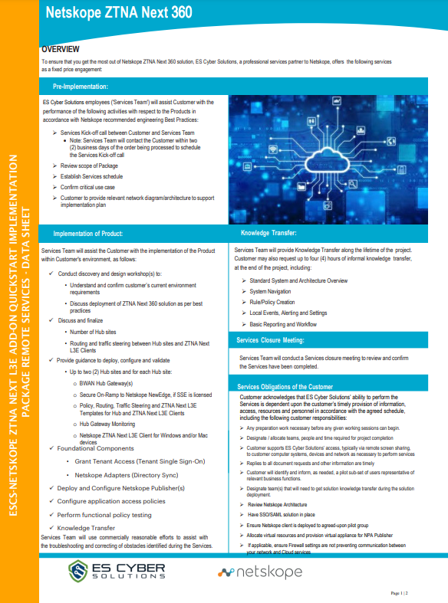
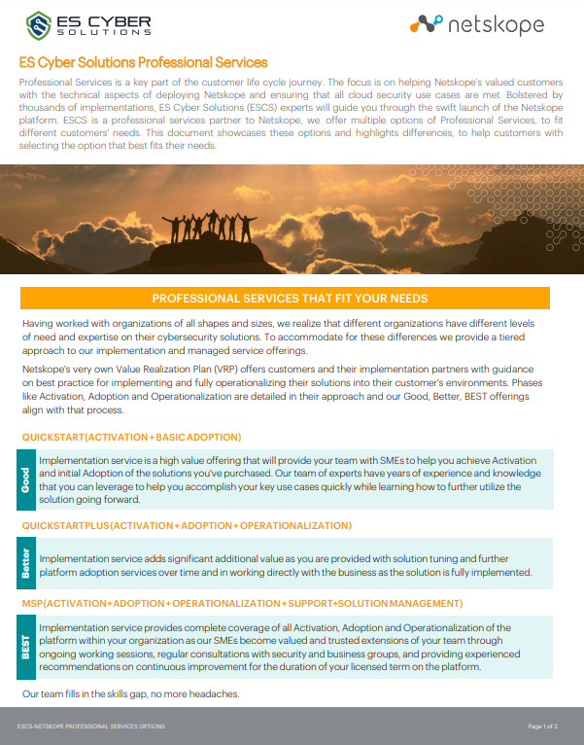
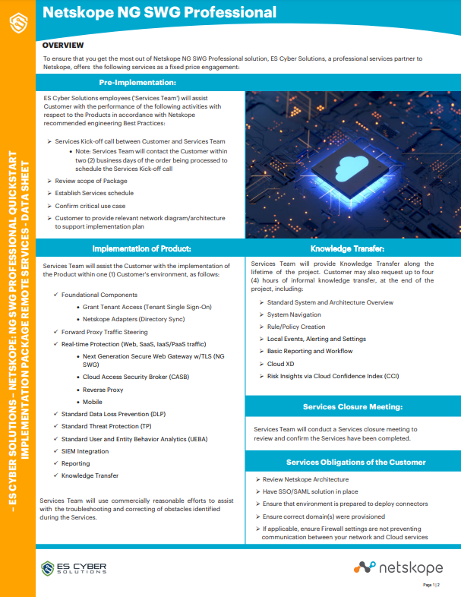
OUR PROGRAM

Slide 8
WHAT SERVICES DOES ES CYBER PROVIDE?
QuickStart Implementation Services
SOW-based/Complex Implementation Services
In-Depth Health Checks
Tuning
Block of Hours for Ad-Hoc support/assistance
Upgrade Services
Managed Security Services
Staff Augmentation

Slide 9
ENGAGING ES Cyber Solutions
Pre-Sales:
Demos (if solid services opportunity)
Early conversations around professional services
Scoping call
Request quote for services be sent to partner contact (provide pertinent information)
  Licenses being discussed
  # of users
  Partner contact
  Any relevant information such as use case(s)
How to engage:
Introduce Dom to partner or customer (email or call)
Provide context
Provide pertinent information:
  Licenses being discussed
  # of users
  Partner contact
  Any relevant information such as use case(s)
Dominic.Astori@escybersolutions.com
Cell#: (480) 347-5061

Slide 10
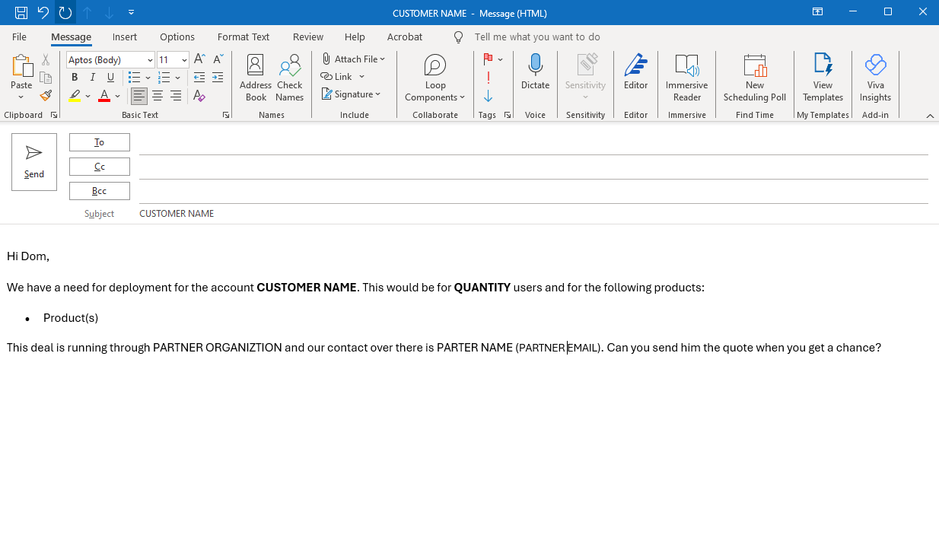
ENGAGING ES Cyber Solutions

Slide 11

Q&A

Slide 12


Contact Us!
If you need more information
about anything.
Pre-Sales, Sales, Renewals
Dominic Astori
Director of Channel Sales
Dominic.Astori@escybersolutions.com
(480) 347-5061
ADDRESS
PHONE & EMAIL
SOCIAL MEDIA
845 Midway Dr.
Willowbrook, IL 60527
info@escybersolutions.com
Sales@escybersolutions.com
1.888.262.6925

